Slide 1
Pivotal Marketplace Overview
An orientation to what, why, and how Pivotal offers services on PCF
Version: August 2015

Slide 2
Agenda
Services Basics
Spring Cloud Services
Data Services
Mobile Services

Slide 3
Marketplace Basics

Slide 4
How do services fit into Pivotal’s solution for cloud-native apps?
Professional Services for Agile, CI/CD
Cloud Native
Data Services
BDS
Services
Pivotal
Labs
Pivotal Cloud Foundry
PCF
Mobile
Services
Spring
Cloud
Services
Cloud Native
Mobile Services
Cloud Native
Application Framework

Slide 5

What is a Marketplace Service?
Allows resources to be easily provisioned on-demand
Typically middleware, frameworks, and other “components” necessary for applications
Can be a persistent, stateful layer

Slide 6

Two Types of Services
Marketplace- Fully integrated, with full lifecycle management
User-Provided – Created and managed external to the platform

Slide 7
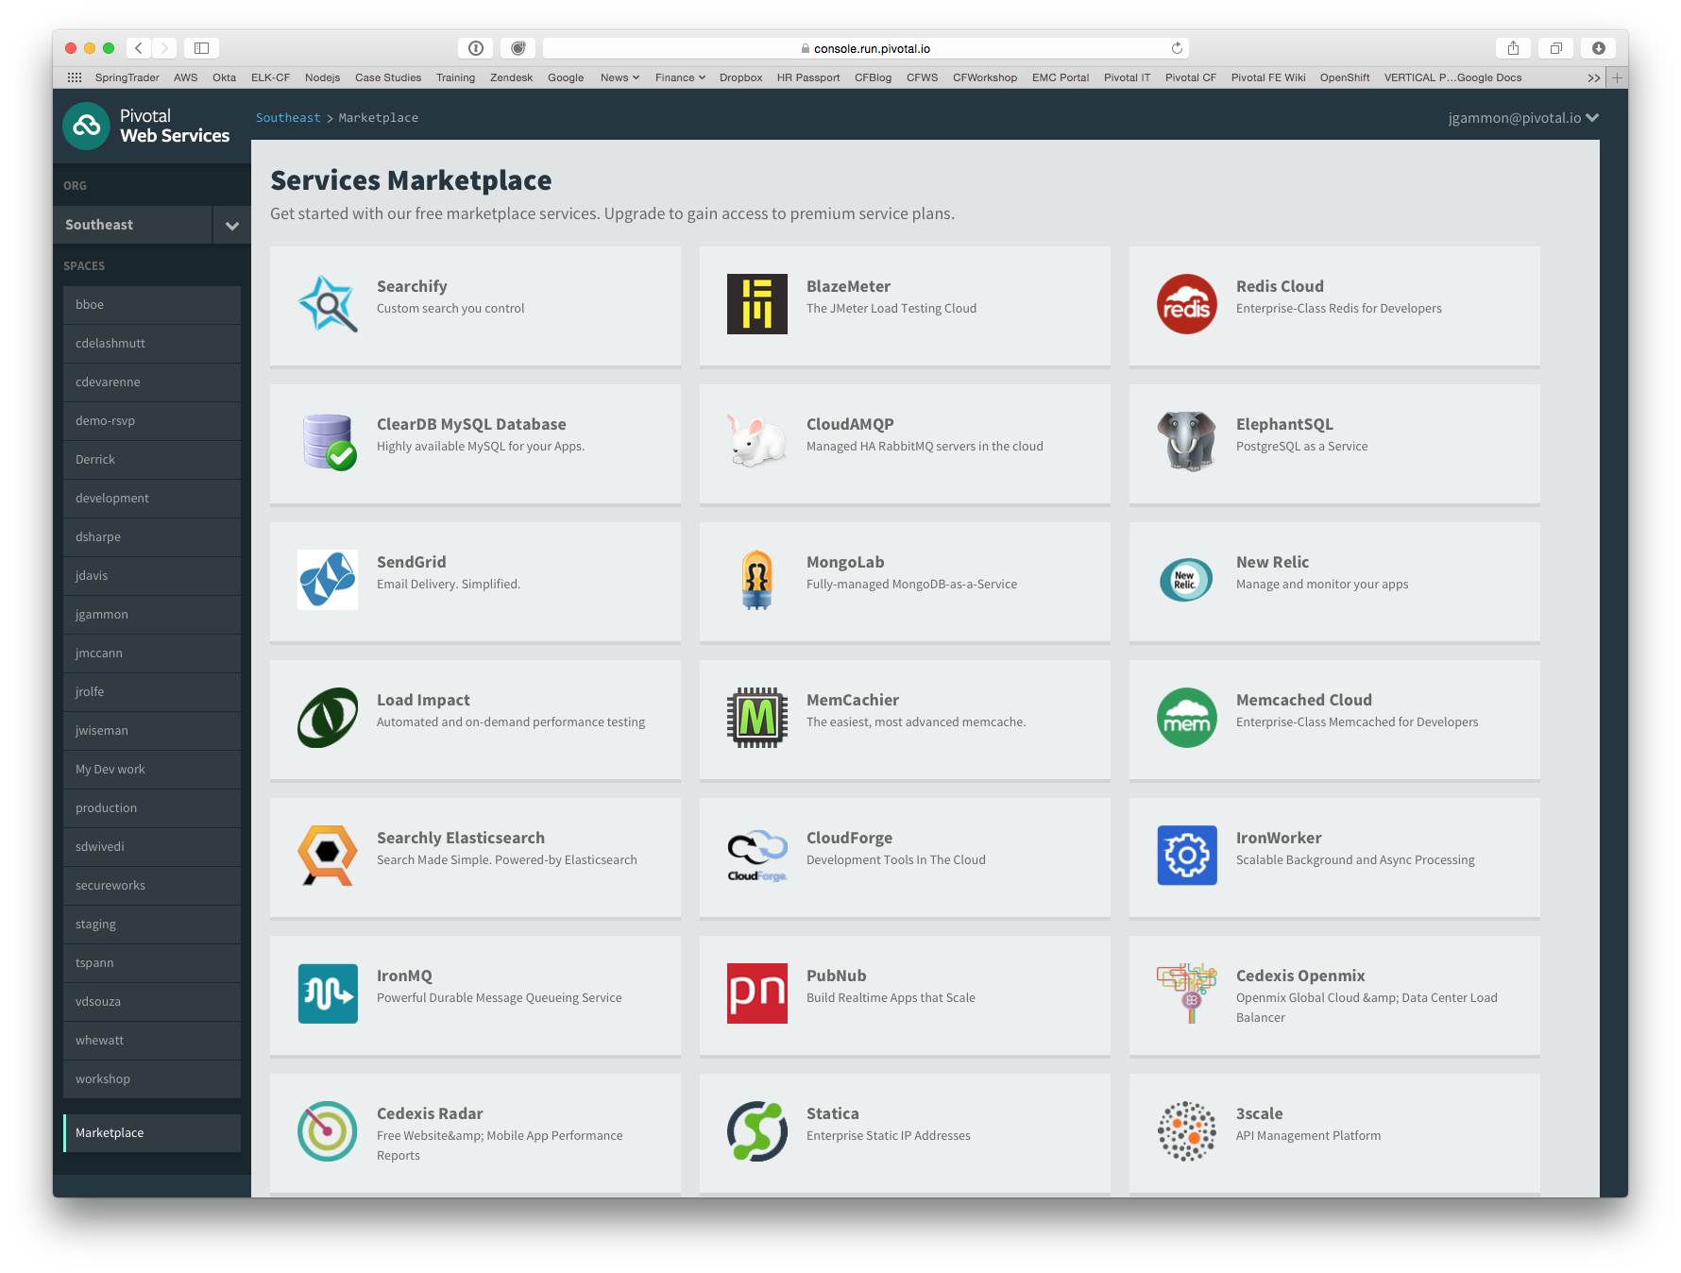

Slide 8
Creating and Binding a Marketplace Service
Service
credentials
DB
CLI
create service (HTTP)
Cloud Controller
create service (HTTP)
Service
Broker
reserve resources
Data
Service
Router
bind service (HTTP)
bind service (HTTP)
obtain connection data
Pivotal Cloud Foundry
Elastic Runtime
Notes:
An application runs in a DEA, which is a droplet execution agent. The Cloud Controller orchestrates the routing and lifecycle of all DEAs in the pool. Routers manage application traffic. Health Manager reports mismatched application states to the CC. A service gateway provides an interface for services (native or external). A messaging bus manages all system communication. Apps are accessed directly through the router while web and CLI clients (e.g., vmc, STS) access Cloud Controller via RESTful services.

Slide 9


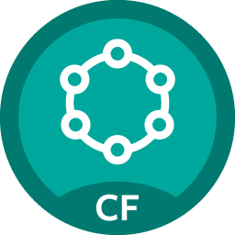
















Pivotal Cloud Foundry Marketplace Services
Mobile
Datastore
Other
SpringCloud
API Gateway
Redis
DataStax Cassandra
Config Server
RabbitMQ
Push Notification
MySQL
GemFire
Jenkins Enterprise
Service Directory
Data Sync
Session state caching
Circuit Breaker
PivotalHD
Spring XD
App Distribution
Single Sign-on
Neo4j
MongoDB

Slide 10

Pivotal Cloud Foundry Marketplace Services
Operated ‘as a Service’
Configured and integrated to enable push button deployment
Full lifecycle management - software updates and patching
Bind to apps through an easy-to-use interface
Common view into access control and audit trails across a breadth of services
EASY
Notes:
In many organizations, provisioning of data and messaging services for applications can take weeks, if not months because of the number of teams, administrators and exchange of credentials involved. We are striving to address this problem by providing a common model for services deployment via Pivotal Cloud Foundry that developers can easily find and their applications bind to – and scale those services as needed.
PCF Services allow administrators to provide pre-defined database and middleware services, and this gives developers the ability to rapidly deploy a software product from a menu of options without the typical slow and manual provisioning process. This is also done in a consistent and supportable way. PCF Services are managed and operated ‘as a Service,’ and this means they are automatically configured upon request. The provisioning process also incorporates full lifecycle management support, like software updates and patching.
This automation removes the overhead from developers, who are often saddled with service configuration responsibility. It makes administrators’ lives easier and addresses security risks by standardizing how services are configured and used.

Slide 11
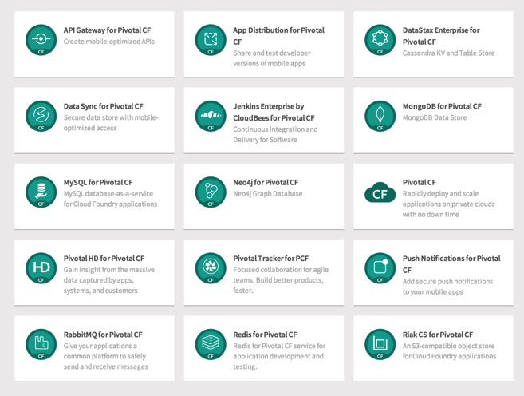
PCF Marketplace
Broad Services Ecosystem
Easy accessibility
Quick, self-provisioning

Slide 12




Spring Cloud
Notes:
http://www.wired.com/wp-content/uploads/2014/06/google-cloud.jpg

Slide 13

Companies want to be fast like Netflix
Netflix needed to be faster to win / disrupt
Pioneer & vocal proponent of microservices - the key to their speed and success
Netflix OSS supplies parts, but it’s not a solution
Difficult for enterprises to build it themselves
Pivotal offers the closest thing to “Netflix in a box” today
“
“Velocity on the JVM is the Killer App”
- Andy Glover (Netflix Eng) @ SpringOne2GX 2014 Keynote
https://youtu.be/xU267-YHN5c?t=1938
Notes:
NetFlix, an undisputed business & technology leader
34% of peak N. American internet traffic from 6-9pm
If speed was why they won, microservices was how
They pioneered / began to popularize micro service concept
All they had was Amazon EC2 back then
They had to invent a distributed platform, cloud native platform with PaaS – like features
They had to invent microservice infrastructure at the application level
All before writing one line of code that relates to the application you and I know as Netflix
NetflixOSS is a talent acquisition and retention strategy, they are in the movie business 1st, and the software business 2nd.
Open source and supporting their developer’s efforts in the industry is how they are able to attract and retain the best engineers, giving them the ability to invent all this stuff.
That’s tough to duplicate.
Detail on Netflix quote: Netflix needed the performance, stability, concurrency of the JVM, but was searching the right RAD capability to give them the velocity they wanted.

Slide 14



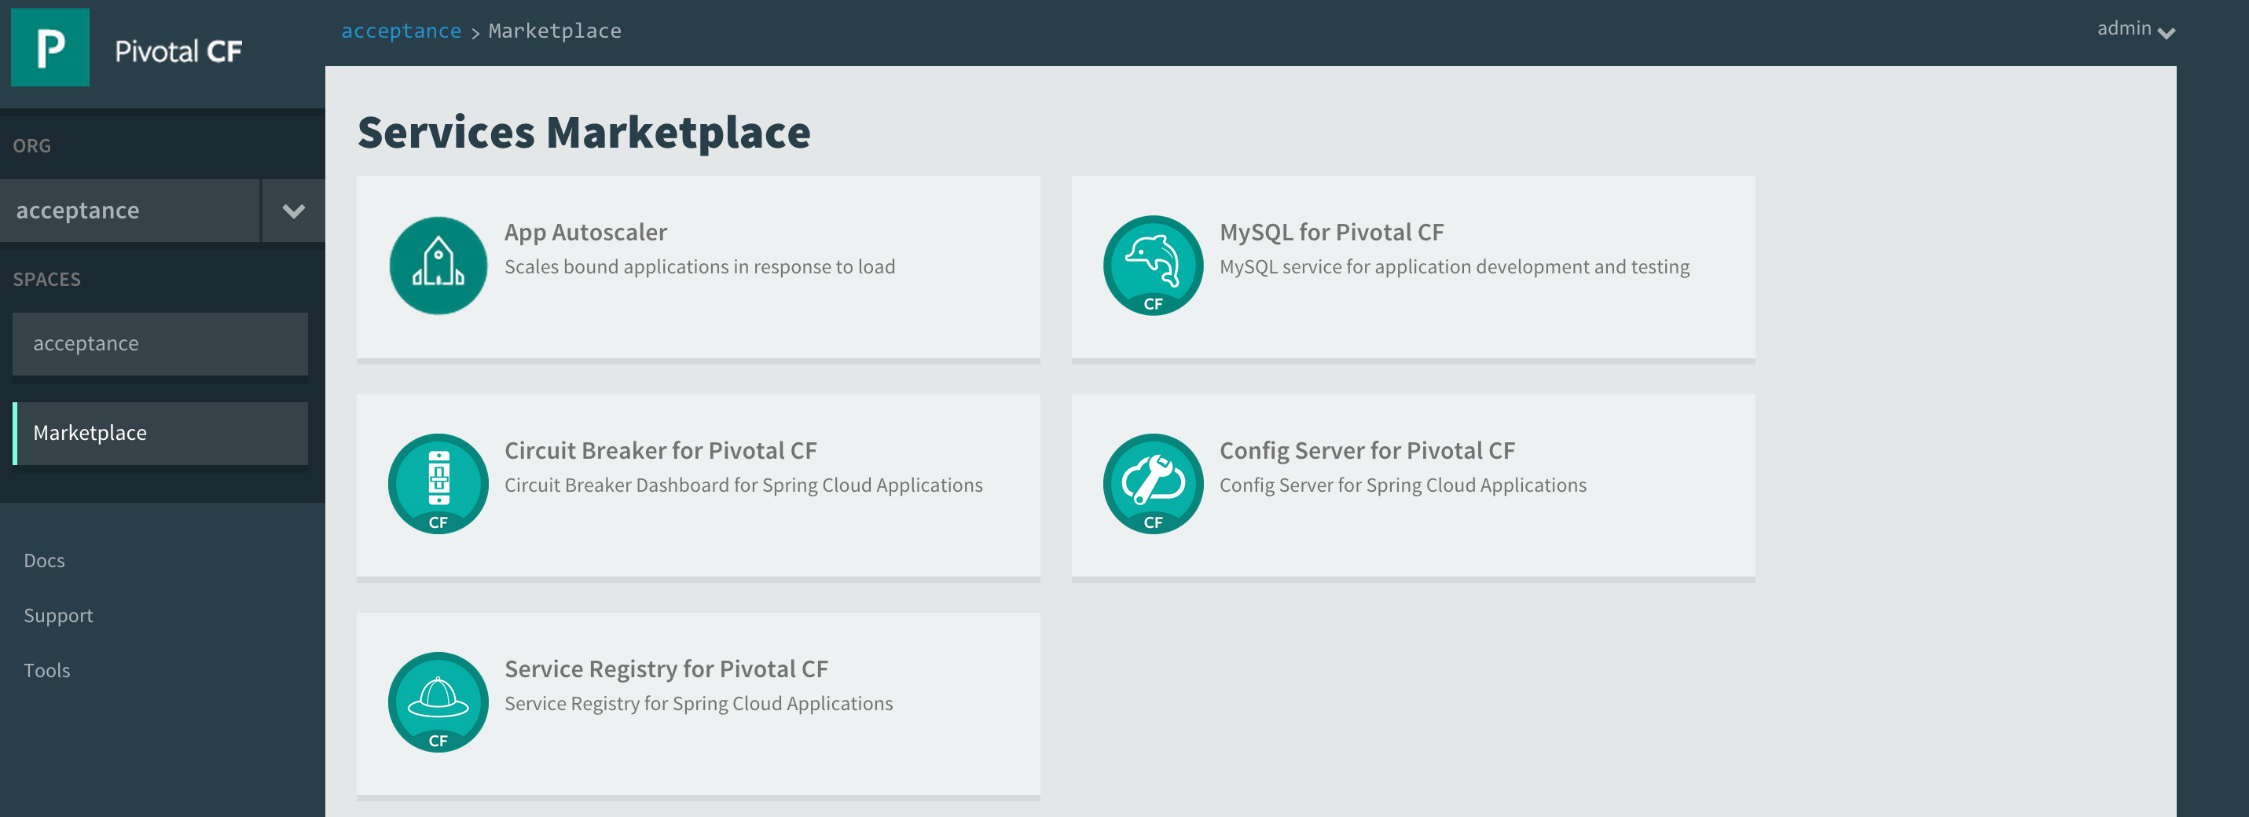

Spring Cloud Services Suite
Installed via Pivotal Ops Manager
Adds all services to Pivotal Cloud Foundry Marketplace
Config Server
Service Registry
Spring Cloud
Services
Circuit Breaker Dashboard
Notes:
ONE CLICK INSTALL
1 config server AI
2 AIs for eureka (for F/T)
2 Ais for Turbine
1 SI for turbine (Rabbit perhaps for pub/sub to hystrix dashboard?)
1 SI for svc broker (mysql) for config server?

Slide 15
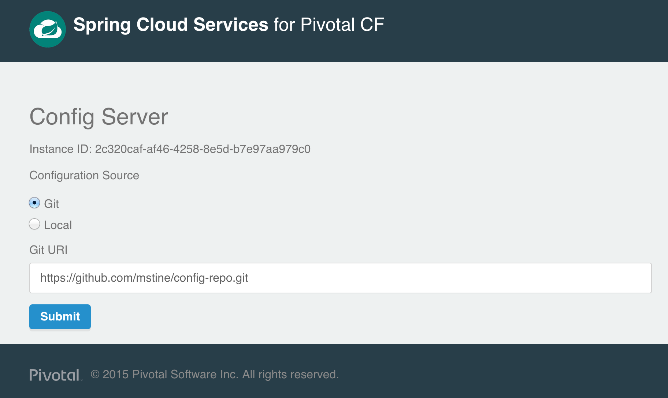

Spring Cloud Config Server
Config Server
Notes:
ASK

Slide 16
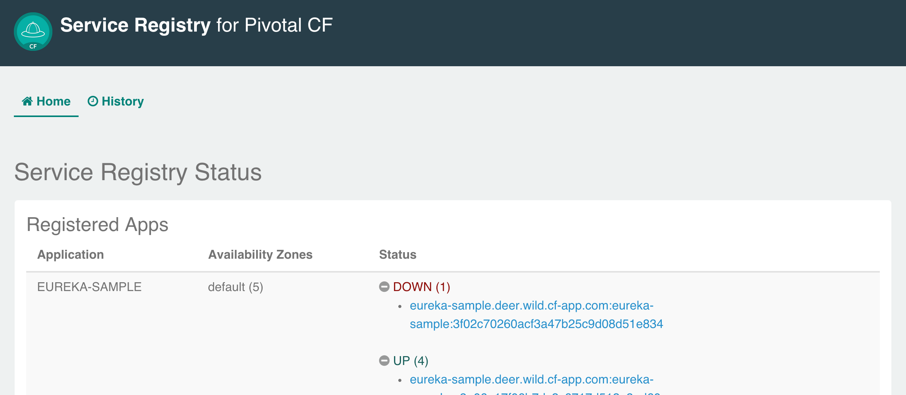

Spring Cloud Service Registry
Service Registry
Notes:
Ask
Consul, Zoookeeper

Slide 17
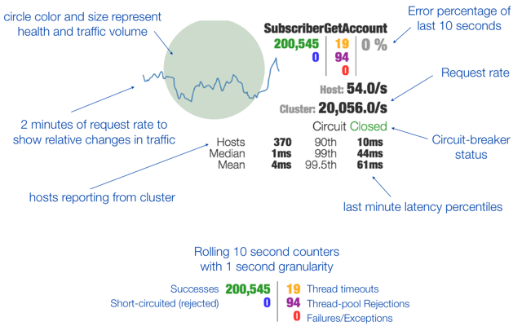

Spring Cloud Circuit Breaker
Circuit Breaker
Dashboard

Slide 18

Big Data

Slide 19
BDS Vision: Make all data products cloud-ready.
Open.
Agile.
Cloud-ready.

Slide 20
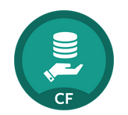
MySQL for Pivotal Cloud Foundry
DBaaS for Your Applications
Push-button deployment and upgrades
Self-healing, synchronously replicated MySQL cluster based on MariaDB Galera Cluster 10.0
No single points of failure
Upgrades without downtime
Automated failover: proxy tier tracks health of all backend cluster nodes
Notes:
Deployed with a multi-node cluster; Balanced across Availability zones
Highly Available
Data replication
Failover functionality
Customizable plans
Secure - Different credentials to each application, operators can revoke access selectively!

Slide 21

Redis for Pivotal Cloud Foundry
DBaaS powered by Redis
Push-button deployment and upgrades
Pre-provision a pool of Redis VMs
Automated back-ups
Consolidated logging and monitoring
VM health monitoring, and recovery
User Application
Binding
Instance (Redis process)
VM
VM
VM
VM
Pre-provisioned VMs in the ‘pool’
Ready to be created as instances and bound with apps
Notes:
Developers can quickly develop features for their applications such as:
live, in-memory caching for very fast reads
real-time computation on data structures
ranked lists and leaderboards
publishing and subscribing
queuing

Slide 22

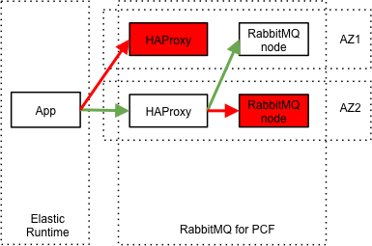
RabbitMQ for Pivotal Cloud Foundry
Apps safely send and receive messages at scale
Push-button deployment and upgrades
Load balanced connections across the cluster
Mirrored queues
Scalable
Management UI for metrics and monitoring

Slide 23

Mobile Services

Slide 24




Diversity of clients, more load
In January 2014, mobile devices accounted for 55% of Internet usage in the United States. Apps made up 47% of Internet traffic and 8% of traffic came from mobile browsers.
http://money.cnn.com/2014/02/28/technology/mobile/mobile-apps-internet/
Notes:
When we established the predominant enterprise architecture paradigms, the vast majority of our clients were usually tethered to a desk with a workstation. Now that has flipped…

Slide 25

Pivotal CF Mobile Services
Consumer-grade, mobile backend services built for the enterprise
Built on Pivotal CF for simplified deployment and operation in private cloud
Enables businesses to apply the power of Pivotal’s Big Data Suite to mobile solutions
Enterprise Backend Applications
Pivotal CF Mobile Services
Push
Notifications
API
Gateway
Data
Sync
App
Distribution
Pivotal CF

Slide 26
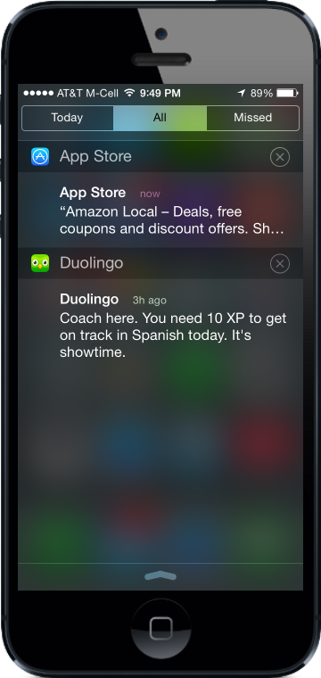
Push Notifications
Problem
Push is difficult to implement across platforms and at scale
Most existing push solutions are public / shared
Data owned by SaaS provider and cannot be fully leveraged by enterprise
Difficult to integrate SaaS push providers with services behind the firewall
Solution / Benefits
Dedicated, comprehensive solution built to scale
Full control of data and comprehensive logging / tracing
Direct integration with enterprise services

Slide 27



Data Sync
Enterprise Backend
Problem
Apps need to store mobile-specific data, but the existing backend cannot accommodate
Data sync / store is difficult for an app developer to set up
Existing services provide public cloud “black box” storage
Solution / Benefits
Mobile-optimized API for access to multiple types of storage
Simple for developers, yet enterprise-grade and highly scalable
Pivotal CF
API Gateway
Redis
Data Sync

Slide 28
API Gateway
Problem
Legacy APIs are not optimized for mobile
Too much unnecessary content delivered to devices
Mobile very sensitive to latency (often weak or no signal)
Mobile apps often require several API calls to display a single page of content
Solution / Benefits
Allows mobile developers to easily transform APIs
Deliver mobile-optimized, device specific content
Results in improved performance and user experience

Slide 29
Thank You!

